Slide 1
The Jimmy Young Program
Notes:
Lori

Slide 2
Conflict of Interest
Lori Tinkler and Robert Shaw are employed by the NBRC.
Notes:
Lori

Slide 3
Learning Objectives
Describe typical features built into a career ladder for respiratory therapists.
Illustrate opportunities to enhance a career ladder with resources from the NBRC.
Apply knowledge of the Dunning-Kruger effect to credential maintenance policies intended to protect patients.
Describe recent activities around advanced practice respiratory therapy.
Notes:
Lori

Slide 4
Through this program, the NBRC has honored the memory of Jimmy Young along with contributions he made to respiratory care since 1978
Jimmy Albert Young, MS, RRT 1935 –1975
Notes:
Lori

Slide 5
Career synopsis
In a 15-year career, Jimmy
achieved the RRT
directed an education program
published a widely-used textbook
directed a hospital department
served as AARC President
served as an NBRC trustee
1935 – born in South Carolina
1960 – 1966 – served as Chief Inhalation Therapist at the Peter Bent Brigham Hospital, Boston
1965 – earned the RRT (#263)
1966 – 1970 – served in several roles including director of the education program at Northeastern University, Boston
1970 – became director of the Respiratory Therapy Department at Massachusetts General Hospital, Boston
1973 – became the AARC’s 22nd President
1975 – was serving as an NBRC Trustee and member of the Executive Committee when he passed away unexpectedly
Notes:
Lori

Slide 6
Leveraging NBRC Resources While Supporting Career Ladders
Notes:
Dan

Slide 7
Career Ladder Examples
Facilities
Children’s Mercy Hospital, MO
INOVA Hospital, VA
Rush University Hospital, IL
Veterans Health Administration Hospital, MD
Akron Children’s Hospital, OH
Notes:
Dan

Slide 8
Example 1 - Levels and expectations
IV | Advanced in once area with additional competencies in multiple other areas | RRT Bachelor’s degree 16 CEUs per year Cross functioning such as inpatient-outpatient, adult-pediatric, outpatient-critical care
III | Advanced in one area with additional competencies in other areas | RRT 16 CEUs per year Specialty credential e.g., ACCS, SDS, AE-C, NPS, RPFT 2 QI projects Committee participation Professional membership
II | Advanced in one area | RRT or CRT+10 years 12 CEUs per year ACLS, PALS, or NRP 1 project
I | Basic | 8 CEUs per year
Notes:
Dan

Slide 9
Example 1 – Starting and progressing
Apply to start on the ladder
May start at any time during the year.
Escalated by Director/Manager to an oversight group for approval
Being in a discipline process is a barrier.
Start at the bottom level, then move up in the sequence.
Maintenance at a level means continuing to satisfy the requirements.
Those at risk of falling from a level can expect to develop an action plan with the Director/Manager.
Notes:
Dan

Slide 10
Example 2 - Levels and expectations
IV | Master’s degree, leadership+5 years, Bachelor’s degree+10 years 30 CEUs | Leadership activity X5 Education or others X4 QI activity X4 Community serviced-12 hours Clinical practice – research, innovation, evidence-based practice X4
III | Adds professional membership Bachelor’s degree, leadership+5 years 30 CEUs | Leadership activity X4 Education of others X4 QI activity X3 Community service-9 hours Clinical practice – research, innovation, evidence-based practice X3
II | Adds national professional certification Bachelor’s degree, leadership+3 years, or Associates+5 years 25 CEUs | Leadership activity X3 Education of others X3 QI activity X2
I | Completes local requirements for at least one year Acquires license 20 CEUs | Leadership activity X1 Education of others X1 QI activity X1
Notes:
Dan

Slide 11
Example 2 – Recognized achievements in leadership
Earn a hospital award or recognition.
Participate in interviews of new potential new hires.
Coordinate the journal club.
Participate in the planning of a conference – local, regional, or national
Hold an office in a professional organization.
Participate in a hospital committee – unit, division, special interest, organization-wide.
Participate in initiates – wellness, error prevention, safety.
Maintain a department newsletter.
Represent the hospital in a community organization.
Represent the profession at open-house, career fair, health fair.
Mentor newer employees.
Notes:
Dan

Slide 12
Example 2 – Recognized achievements in the education-of-others
Act as a super-user.
Precept new employees.
Supervise students or colleagues.
Implement a department competency assessment verification method.
Instruct at a national course.
Present an article at journal club.
Provide community-based education.
Present during a department update, class, or meeting.
Present at a higher education institution.
Present a poster or presentation at a conference – local, regional, national.
Develop an informational brochure for patient, family, or staff.
Author an article.
Notes:
Dan

Slide 13
Example 2 – Recognized achievements in community service
Volunteer time to philanthropic events.
Volunteer time to children’s clubs or organizations.
Serve on a school PTO or similar volunteer activity.
Lead a Neighborhood association.
Volunteer time on a mission trip.
Participate with community organizations – Salvation Army, church.
Notes:
Dan

Slide 14
Example 2 – Recognized achievements in quality improvement
Participate in department quality initiative.
Participate in quality data collection for a project directed by the department quality coordinator.
Participate in QI team or committee.
Present quality-related poster or presentation.
Participate in a workshop for Lean System Daily Management or Lean Rapid Process Improvement.
Teach modules within an improvement academy course.
Complete a huddle.
Summarize an organizational management book.
Author a peer-reviewed quality project.
Act as a unit/department infection prevention and control advocate.
Notes:
Dan

Slide 15
Example 2 – Recognized achievements in clinical practice analytics
Integrate best practice evidence with clinical expertise and patient values.
Revise a policy or procedure about clinical practice.
Implement an educational plan that disseminates the care approach from literature or consensus.
Present findings about evidence-based practice to service line personnel.
Author an evidence-based practice manuscript in a peer-reviewed publication.
Present evidence-based practice guidance in a poster or presentation at a conference – local, regional, national.
Participate as a member of the evidence-based practice scholars' program.
Contribute to updates as an item writer for a national examination.
Edit a textbook in the professional discipline.
Author a chapter in a discipline’s textbook.
Presents a clinical practice assessment to staff.
Attain a higher, or specialty, certification.
Apply an advanced competency or technique to 10 patients.
Implement a new test, instrument, or method.
Notes:
Dan

Slide 16
Example 2 – Recognized achievements in research
Author a research protocol approved by the IRB.
Author the background section of a research protocol submitted to the IRB.
Serve as the principle investigator or sub-investigator for an active protocol approved by the IRB.
Collect study data from the charts of at least 35 patients within a one-year time frame.
Enroll subjects who have consented for a research study.
Analyze study data after the collection period is completed.
Present results of research findings to patient care services, grand rounds, or a research symposium.
Publish a research manuscript in a peer-reviewed publication.
Present research findings in a poster or presentation at a conference – local, regional, national.
Participate as a member of the IRB.
Notes:
Dan

Slide 17
Example 3 - Levels and expectations
Clinical Manager | Paid by salary 24/7 responsibilities Controls activities of one of four sections. Supervises staff, schedules, assignments, and daily operations. | Responsible for equipment, procedures, and supplies. Monitors expenses and revenue plus care provided by staff. Acts as a liaison among departments, families, and medical staff.
III | Paid by the hour Provide leadership to optimize patient care while ensuring quality and safety. Provide training to increase skills and competencies of staff. Ensure communication among staff, physicians, and nurses. | Assist with development of protocols and guidelines. Conducts staff performance evaluations. Leads committees Coordinates research
II | Paid by the hour Function as a clinical specialist in critical care of adults or neonates/pediatrics. Orient new employees and precept students. | Provide charge therapist and critical care team leader duties. Serve on department committees. Bachelor’s degree RRT-ACCS or RRT-NPS
I | Paid by the hour. Independently function in adult or pediatric/neonatal areas. Is a member of national professional association and state chapter. | RRT State license Pass departmental competencies BLS or PALS before start ACLS or NRP within 90 days of start
Notes:
Dan

Slide 18
Example 4 - Titles and expectations
GS 15 National Program Manager | Maintain license and RRT
GS 14 Chief of Respiratory Care Services | Maintain license and RRT
GS 13 Assistant Chief of Respiratory Care or Program Manager including Advanced Practice Respiratory Care Practitioner | Maintain license and RRT, one year of GS 12 equivalent experience, demonstrated APRT KSAs
GS 12 Lead Respiratory Therapist or Program Coordinator | Maintain license and RRT
GS 7, 9, or 11 Registered Respiratory therapist | Maintain license at RRT level
GS 5 Respiratory Therapist | Completion of CoARC program
Other requirements:
Citizen of the United States unless a shortage is documented
Notes:
Dan

Slide 19
Example 5 – Integration with NBRC credential maintenance assessments
Career Ladder Domains
Clinical | Educational | Leadership
 | Assessment participation matches educational experiences to learning needs | Assessment participation demonstrates the following: Awareness of one’s strengths and opportunities Taking responsibility for one’s own professional development Proactively seeks learning opportunities
Notes:
Dan

Slide 20
Example 5
Financial incentives
Individuals on the career ladder receive a lump sum bonus.
Fees are reimbursed
Educational advancement to Baccalaureate or Masters levels
Specialty credentials, for example, RRT-NPS, RPFT
Professional membership, for example, AARC, SCCM
Recognitions
Lapel pin
Certificate for each level
Notes:
Dan

Slide 21
Summarizing career ladder examples
Monetary
Hourly or salaried
Increased compensation with ladder advancement
Reimbursing fees
Responsibility – shift or 24/7
Cross functionality – inpatient/outpatient, adult/children, therapeutics/diagnostics
Continuing education credit levels – lower or higher
Highest academic degree – undergraduate or graduate
General or specialty NBRC credential achievement and maintenance
License maintenance
Notes:
Dan

Slide 22
Summarizing career ladder examples
Activity domains
Leadership
Education of self or others
Quality improvement
Clinical
Research
Volunteering
Profession
Community
Presentations
Authorship
Notes:
Dan

Slide 23
Credential maintenance program information and potential uses within career ladders
Notes:
Rob

Slide 24
What broad domains do assessments cover?
General respiratory therapy
Therapists who maintain CRT and RRT.
Pulmonary function technology
Technologists who maintain CPFT and RPFT.
Sleep Disorders Specialty
Therapists who maintain the CRT-SDS and RRT-SDS.
Neonatal / Pediatric Specialty
Therapists who maintain the CRT-NPS and RRT-NPS
Adult Critical Care Specialty
Therapists who maintain the RRT-ACCS.
Asthma Educator Specialty
Personnel who maintain the AE-C.
Notes:
Rob

Slide 25
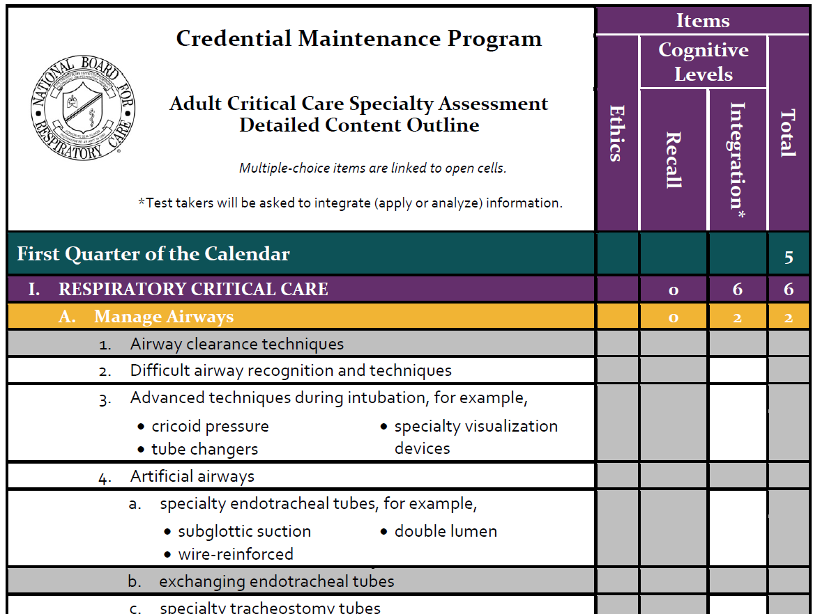
What justifies the content that stimulates each new item?
Those who are maintaining a credential are surveyed.
Responses reveal those activities that put patients at high risk and experience high knowledge turnover.
Among activities covered by examinations for initial credentialing, assessments focus on high-risk plus high-turnover content.
Notes:
Rob

Slide 26
Consider the alternative
Participants interact with continuing education that is convenient for them to obtain.
Even if preceded by a self-evaluation of learning needs, an individual may not identify their true deficits or match those up with sufficient remediation.
Kruger J & Dunning D. (1999).Unskilled and Unaware of It: How Difficulties in Recognizing One’s Own Incompetence Lead to Inflated Self-Assessments. Journal of Personality and Social Psychology, 77(6), 1121-1134, https://doi.org/10.1037/0022-3514.77.6.1121
Notes:
Rob

Slide 27
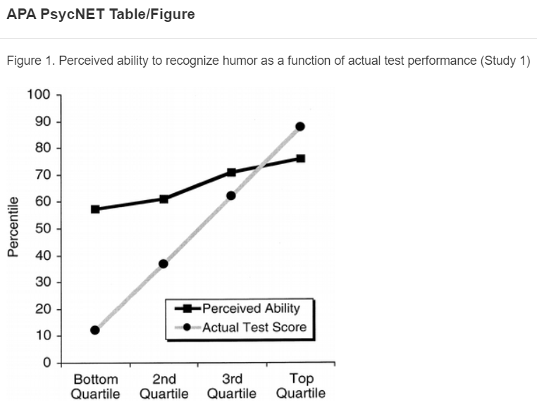
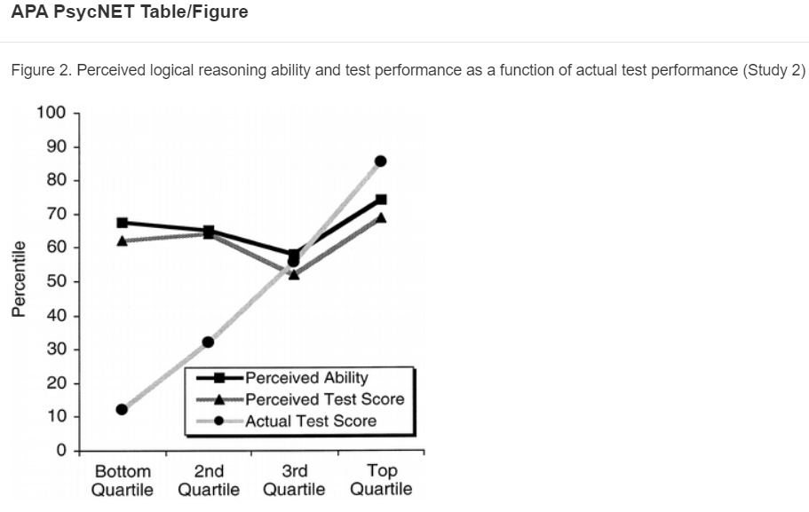
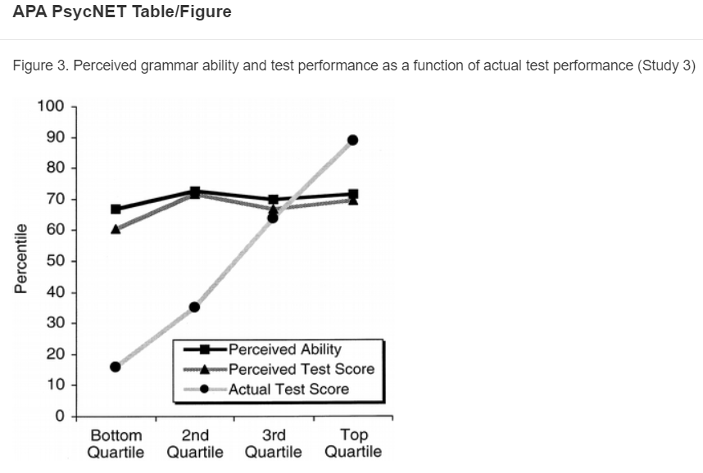
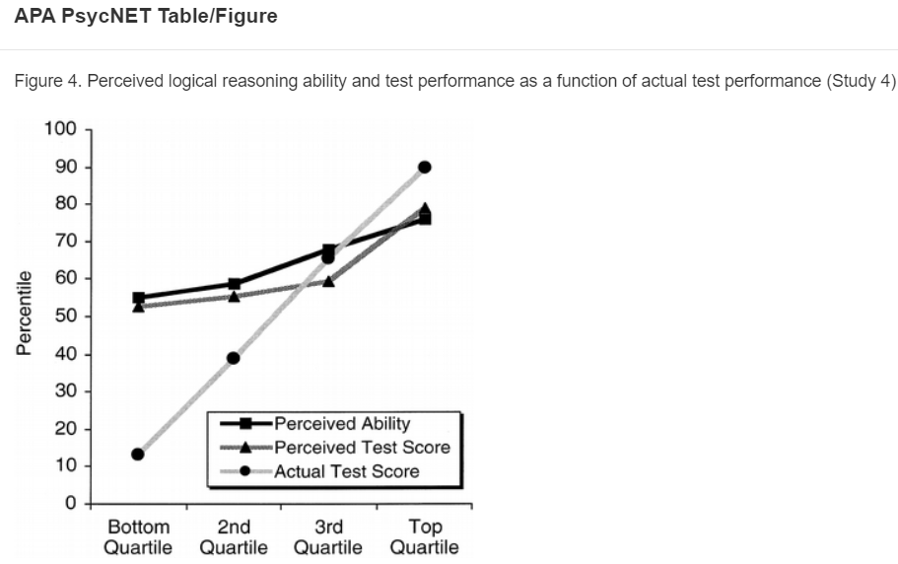
Dunning-Kruger Observations
Ability to recognize humor
Ability to apply logical reasoning
Ability to apply grammar
After training, ability to logically reason
Notes:
Rob

Slide 28
Conclusions of Dunning & Kruger
Those in the bottom quartile not only overestimated their abilities by a large amount, but also perceived their abilities to be higher than the measured average.
“The same incompetence that leads them to make wrong choices also deprives them of the savvy necessary to recognize competence, be it their own or anyone else’s.”
After inviting back the bottom and top quartiles to allow observations of peers, “despite seeing superior performances of their peers, bottom-quartile participants continued to hold the mistaken impression that they had performed just fine.”
The accuracy of self-appraisals increased among high performers after observing peers.
Notes:
Rob

Slide 29
Who decides what assessments cover?
A panel of 8 members who are also maintaining the general respiratory therapy credential.
Panels of 6 members each who also are maintaining each specialty credential.
Members of each panel do the following each year:
After staff have evaluated needs, write new items as assigned.
Give feedback to another writer about each new item.
Convene with panel members and staff to edit and then approve each new item, its explanations, and its reference citation.
Contribute individually to a key validation.
Resolve key validation disagreements and comments.
Contribute data that inform the passing standard for each quarter’s assessment.
Notes:
Rob

Slide 30
What feedback do assessments provide to participants?
Whether the best response was selected.
The proportion of peers who selected the best response.
The explanation of the best response plus each distractor.
A reference citation that supports the best response.
A Most Missed Concepts write-up of topics about which therapists confidently selected an incorrect response.
Notes:
Rob

Slide 31
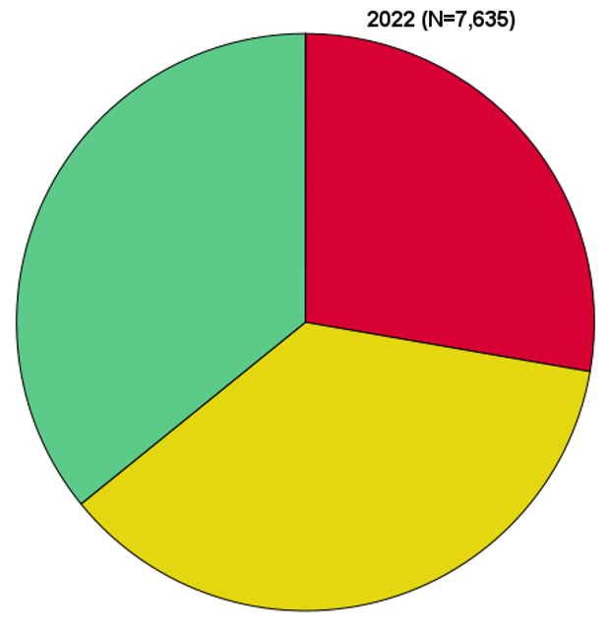
Besides self-improvement, which can be challenging to quantify, can credential maintenance otherwise help a therapist in an obvious way?
A 90% participation level over the four assessments from a calendar year will yield free CRCE.
General respiratory therapy = 6
Each specialty = 3
In 2022, there were 16,064 therapist who earned CRCE this way.
Among those who answered every assessment item, most decreased the number of continuing education credits to be documented in the NBRC system.
Notes:
Rob. Participation means to have submitted an item response rather than submit the correct response.

Slide 32
Feedback from the credential maintenance program
Notes:
Lori

Slide 33
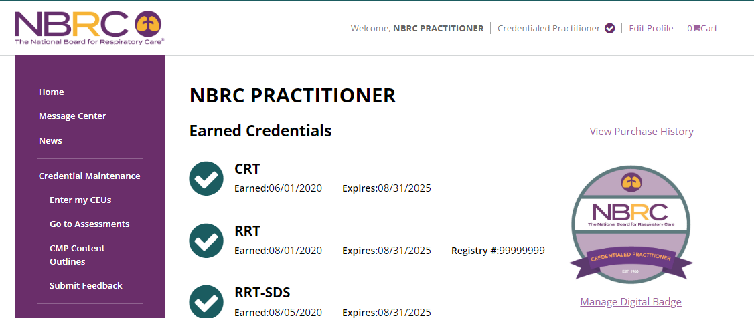
Notes:
Lori

Slide 34
Survey Flow
Yes
Have you completed a CMP assessment?
No
About what would you like to provide feedback?
About which of the following topics do you need additional info?
I am unclear about details regarding CMP.
I think an assessment item has a flaw.
What is CMP?
Are assessments required?
What if I perform poorly?
What should I study?
Why did I get a reminder?
Is my credential about to expire?
What happens if I lose internet?
Why did I get zero points?*
I forgot to do an assessment.*
Other (please specify)
In what assessment did you see the flawed item?
ACCS
PFT
NPS
SDS
TMC
Explain the flaw.
* Added 2/23/2022
Notes:
Lori

Slide 35
Most respondents have completed an assessment and use the survey to learn more details about the CMP
Q1 2021 thru Q1 2023
n=1,919
n=1,074
Notes:
Lori

Slide 36
Top two most frequently asked topics
Will I lose my credential if I don’t perform well? (% of respondents who selected)
Are the CMP Assessments Required?
(% of respondents who selected)
Notes:
Lori

Slide 37
Interest in “What is the Credential Maintenance Program (CMP)?” has remained fairly constant
What is the Credential Maintenance Program (CMP)?
(% of respondents who selected)
Notes:
Lori

Slide 38
For topics related to reminders, there has been more concern about completed documentation than expiring credentials
I’ve already submitted CEU documentation. Why am I receiving a reminder about completing the quarterly CMP assessment?
(% of respondents who selected)
I received a reminder about the CMP assessment. Is my credential about to expire?
(% of respondents who selected)
Notes:
Lori

Slide 39
Concerns to be addressed before completing an assessment have been of greater interest than potential issues during an assessment
Should I study for the CMP assessments and what resources should I use?
(% of respondents who selected)
What happens if I lose my internet connection while I’m completing a CMP assessment?
(% of respondents who selected)
Notes:
Lori

Slide 40
Respondents may submit topics about which they would like more information
New topics have been added to the list following analysis of respondents’ submissions and changes to CMP policies.
I forgot to do an assessment. May I do it now?
(% of respondents who selected)
Why did I get zero points?
(% of respondents who selected)
Notes:
Lori

Slide 41
Have questions about the CMP?
Answers to the questions from the CMP survey
CMP FAQs
“What is the Credential Maintenance Program?” video
For additional assistance, email cmpsupport@nbrc.org
Notes:
Lori

Slide 42
Potential uses of specialty credentials within career ladders
Notes:
Dan

Slide 43
In one sense, specialty NBRC credentials are a purer form of occupational certification.
A typical candidate for ACCS, NPS, PFT, SDS, and AEC credentials is eligible without additional formal education.
Such a process fits well with the intent behind a career ladder that recognizes advancement, enrichment, and new achievements.
The specialty examination pass/fail result mostly just reflects on the individual rather than an education program or an employer.
About 65% of therapists (n=692) maintain at least one specialty credential while tending to work in large facilities.
Personal reasons are stronger motivations for getting a specialty credential such as satisfaction, dedication, and advancement, compared to compensation.
Among those who do not intend to get a specialty credential, tendencies are more experience, more education, wider variety of settings, and fewer interactions with specialty credential holders.
Notes:
Dan
Survey results are from a 10,000-person sample from the therapist population.

Slide 44
Real-life specialty credential integration
Within the career ladder examples, moving to the second or third step, out of four steps, typically includes achievement of a specialty NBRC credential.
Such achievement is an observable way to document the following, which employers value:
Deeper learning
Cross-functionality enabling nimble responses to changing patient-mix needs
Stronger professional commitment
Staff with specialty credentials feel they have more control over assignments.
Some leadership positions require specialty credentials.
Notes:
Dan

Slide 45
If APRT jobs expand, it is uncertain whether RT career ladders add a step or the individual moves to a different ladder
The current state of things
There is one formal education program in the state of Ohio while a handful of other programs have been discussed.
There is one person occupying an APRT pulmonary division job within the VA Maryland Health System; a second such sleep division job is under evaluation.
The state of North Carolina is evaluating an APRT license.
The NBRC starts developing an APRT Outcomes Examination in 2023 under staff guidance while involving personnel from CoARC, Ohio, the VA in Maryland, and North Carolina.
Also represented are physicians, a nurse practitioner, and therapists.
An APRT Credentialing and Examination Committee is supported by the AARC, chaired by David Vines & Bill Croft.
Notes:
Dan

Slide 46
Summary Points
Notes:
Dan

Slide 47
Career ladders can show respiratory care personnel a pathway that can encourage the following:
Better patient care
Increased therapist engagement
Persistence in the job
Showing a roadmap for career progression
Notes:
Dan

Slide 48
Typical characteristics of career ladders
Describes how money can be spent on career-supporting expenses and how personnel are compensated.
Often leverages achievement and maintenance of academic degrees, licenses, and credentials as necessary steps for advancement.
Defines domains of enriching activities in which therapists can also engage to advance.
Notes:
Dan

Slide 49
Each new department that integrates the credential maintenance program into its operations can help answer persistent questions held by therapists.
Are credential maintenance assessments required?
No
However, you will help your patients and yourself by participating.
Can credential maintenance assessments cause me to lose my credential?
No
However, failing to document enough, or any, continuing education credits about the topics dictated by the credentials you are maintaining will do so.
For example, an RRT-NPS has two domains to maintain, while an RRT-ACCS, RPFT has three.
Notes:
Lori

Slide 50
NBRC resources in the form of initial credentialing, specialty credentials, and credential maintenance can contribute to future career ladders.
Programs in specialty areas can help document new cross-function competence and its maintenance.
I used to just do general RT, but this new or maintained credential indicates I can also do the following:
Diagnostics – pulmonary function, sleep
Children – neonates, pediatrics
Critical care – adults, children
Asthma education
Credential maintenance program assessments are the antidote to ability degradations into the low Dunning-Kruger zones.
Notes:
Lori

Slide 51
The Dunning-Kruger effect in the respiratory care population
Abilities in the lowest quartiles are likely screened out at entry.
Pre-requisite college-level courses must be completed.
Education program entry typically involves an application and admission process.
Education gives feedback about overconfidence when mistakes are made; most learn, those who do not should not graduate.
Notes:
Rob

Slide 52
The Dunning-Kruger effect in the respiratory care population, continued
Some abilities that made it through the screening of an education program might subsequently degrade into the low quartiles.
After entering respiratory care, maintenance shifts to the (1) therapist, (2) employer, (3) state, and (4) NBRC.
Those who stop working, let the license lapse, or let the credential expire may experience degradation, but not realize it.
An employer or state can mandate its therapists maintain a credential after earning it and the manner (CE vs. quarterly assessments) in which it is maintained.
Credential maintenance assessments are the antidote to the Dunning-Kruger effect because they intentionally…
present high-risk + high-knowledge-turnover content, and
repeat content about which large subsets of therapists confidently selected the incorrect answer.
Notes:
Rob

Slide 53
How to reach the NBRC
Mail:
10801 Mastin Street, Suite 300 Overland Park, KS 66210
Phone:
913-895-4900
Email:
info@nbrc.org
Online:
Live chat at www.nbrc.org
Social Media #NBRC #ExcellenceDefinesUs
#ChooseRT #MoreRTs
@NBRC_tweets
@the_nbrc
@the_nbrc
Notes:
Rob

