Slide 1
The Jimmy A. Young Memorial Lecture
Katherine L. Fedor, MBA, RRT, RRT-NPS, CPFT
Past President
Lori M. Tinkler, MBA
Chief Executive Officer
Robert C. Shaw Jr., PhD, RRT, FAARC
Vice President of Examinations

Slide 2
Conflict of Interest
Lori Tinkler and Robert Shaw are employed by the NBRC.
Notes:
NOTE: Please list your COI’s with the attendees. If there are none, do not skip this slide instead add “Nothing to disclose.”

Slide 3
The NBRC has honored Jimmy’s memory and the contributions he made to respiratory care through this program since 1978
Jimmy Albert Young, MS, RRT 1935 –1975

Slide 4
Jimmy Albert Young, MS, RRT was a most outstanding and dedicated leader
In a 15-year career, Jimmy
achieved the RRT
directed an education program
published a widely-used textbook
directed a hospital department
served as AARC President
served as an NBRC trustee
1935 – born in South Carolina
1960 – 1966 – served as Chief Inhalation Therapist at the Peter Bent Brigham Hospital, Boston
1965 – earned the RRT (#263)
1966 – 1970 – served in several roles including director of the education program at Northeastern University, Boston
1970 – became director of the Respiratory Therapy Department at Massachusetts General Hospital, Boston
1973 – became the AARC’s 22nd President
1975 – was serving as an NBRC Trustee and member of the Executive Committee when he passed away unexpectedly

Slide 5
Observations from the Credential Maintenance Program

Slide 6
Learning objectives
Explain the way the credential maintenance program operates including its features.
Describe how people who have achieved credentials have participated in the program.
Visualize assessment performance levels achieved by participants.
Evaluate the degree to which it is in patients’ interests for therapists to engage with the longitudinal assessments.
Notes:
RRT-ACCS and RRT-NPS 2018
CRT and RRT 2020
CPFT and RPFT 2022
CRT-SDS and RRT-SDS 2023

Slide 7
How the program operates

Slide 8
Program Features
5-year renewal cycles for credentials achieved after July 2002.
Cycle resets when a specialty credential is achieved.
Up to 30 CE credits documented about learning activities from inside the renewal cycle.
Quarterly longitudinal assessment performances can halve or zero CE credits to be documented.
Decision about CE quantity is made after 16 quarters.
When there are multiple credentials to maintain, the decision depends on the sum of correct responses across quarters and assessment types.
Assessment types are as follows:
respiratory therapy
pulmonary function
sleep disorders
adult critical care
neonatal / pediatric
Notes:
If you hold a credential for life and a credential that expires, then assessment performance level is based on both assessments.

Slide 9
Program Features
Ability to interact with CMP features requires authentication through one’s record https://practitionerportal.nbrc.org/; these features include the following:
Notification about the CE quantity to be documented.
Space to document CE; can download CRCE from AARC member record.
Longitudinal learning about high-risk plus high-change competencies encouraged through quarterly assessment releases.
Feedback about one’s aggregated assessment performance.
Feedback about each item from each assessment including peer performance.
Reference citation with each item.
Notifications about pending credential expirations and releases of longitudinal assessments are sent to one’s email address as recorded in the NBRC account.
Final notice arrives as a letter sent to the street address on record; participants maintain their own records.

Slide 10
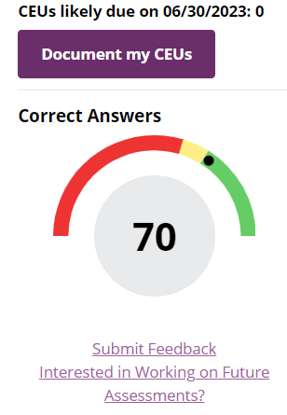
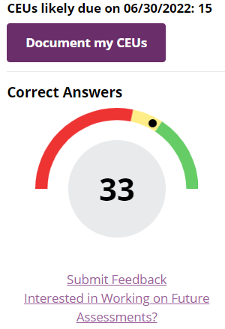
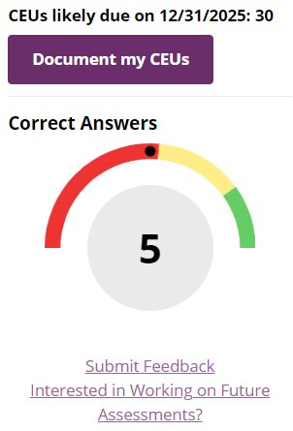
Dashboard
Participants access assessments with any device they choose while using a browser; each item persists for 5 minutes.
General + 2 specialties; 100 items
General; 50 items
General; 10 items

Slide 11
Observations about participant engagement and performance

Slide 13
Notes:
10 items were available during the 4th quarter; the only way to achieve a score that was greater than 7 was to respond to all 10 items.

Slide 14
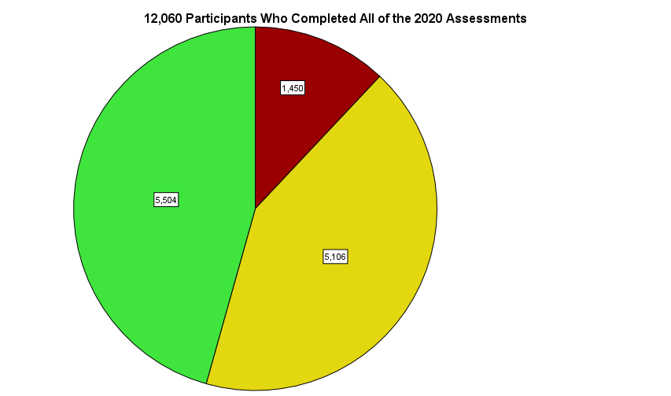
Notes:
88% of participants who responded to all the assessments were able to at least halve the quantity of CE they likely will have to document while 12% were in the red zone.

Slide 15
Notes:
Available to participants in their practitioner portals.

Slide 16
https://www.nbrc.org/news/
Three-part series of short articles summarizing participants’ experiences and feedback.

Slide 17
Extrapolations
12% of a 12K sample were in the red zone after one year of assessments of high-risk plus high-change content.
A 2020 HR study found 170K licenses held by respiratory therapists; even allowing for some duplications the expected count of red-zone cases would be about 20K.
More populous states have more of these cases while less populous states have less, but the average would be about 400 per state.

Slide 18
A manager’s opportunity
Many of you are responsible for the care provided by groups of respiratory therapists.
If a therapist in your group was performing below expectations, would you want to make sure that he or she knew it?
You could choose to direct your group to CMP assessments and expect that continual learning opportunities are embedded with the feedback the program provides.

Slide 19
Example
Akron Children’s Hospital has a career ladder that includes the following benefits:
Lump sum bonus
Fee reimbursement
Educational advancement (for example, Baccalaureate, Masters)
Specialty credentials (for example, RRT-NPS)
Professional memberships (for example, AARC, SCCM)
Recognition
Lapel pin
Certificate for each level
Notes:
Terry Volsko, the 2020 recipient of the Jimmy Young medal, is the respiratory care director at Akron Children’s Hospital.

Slide 20
Example
The Akron Children’s Hospital career ladder recognizes RRTs who demonstrate expertise in clinical, educational, or leadership domains.
Participation in CMP assessments accumulates points for the following leadership competencies.
Demonstrates awareness of one’s strengths and opportunities.
Takes responsibility for one’s own professional development.
Proactively seeks learning opportunities.
Participation in CMP assessments accumulates education points.
By presenting each question first, adult learners’ openness to new learning is intentionally encouraged.
Learning needs are matched to educational experiences by each item including peer performance feedback, an explanation of each option, and a literature citation.
Managers consider CMP assessment participation during annual performance reviews of team members.

Slide 21
Summary
CMP features provide continual learning opportunities but only when therapists engage with assessments.
The Board of Trustees has not mandated assessment participation, but those who are responsible for care provided by groups of therapists can encourage participation.
Participation intentionally exposes therapists and specialists to content about high-risk domains of patient care that also show high-change in underlying knowledge, which a patient will think is superior to self-directed learning.
When directing one’s own learning, one does not know one’s own gaps.

Slide 22
Thank you for the opportunity
10801 Mastin St
Suite 300
Overland Park, KS 66210
nbrc-info@nbrc.org
913-895-4900
instagram.com/the_nbrc
twitter.com/NBRC_tweets
facebook.com/NBRC.org/
linkedin.com/company/
national-board-for-respiratory-care/

